Slide 1
Stock Market Prediction
Comparison of Multiple strategies for Maximized performance

Slide 2
The challenge
Due to the high number of rapidly changing forecast factors, there are no consistent patterns in stock market data that allow an analyst or investor to model stock prices over time with near-perfect accuracy
Several different machine learning techniques and algorithms have been used.
This project presents four different time series machine learning models created to predict future stock market price movements. My initial forecast was predicted using an LSTM model that was then compared to a liner regression model, decision tree model, and finally an XGBoost model. As a final step, the one day moving average was also determined using a standard averaging technique and the exponential moving average. The purpose of this was to compare the long-range prediction accuracy to single step accuracy.

Slide 3
The Models
LSTM Neural Network
Liner Regression
Decision Tree
XGBoost
Additional comparisons: Simple Moving Average, Exponential Moving Average

Slide 4
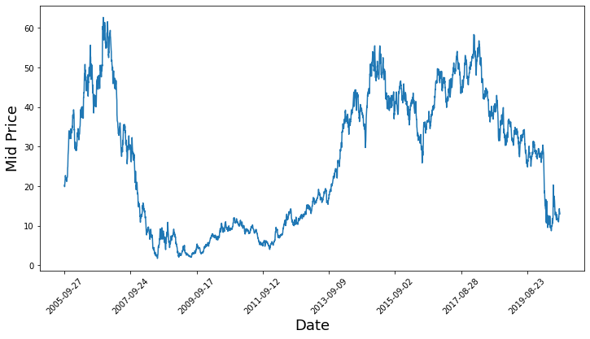
Data acquisition
Data imported from Alpha Vantage
Initial Summary:
Int64Index: 3748 entries, 0 to 3747
Data columns (total 5 columns):
# Column Non-Null Count Dtype
--- ------ -------------- -----
0 Date 3748 non-null object
1 Low 3748 non-null object
2 High 3748 non-null object
3 Close 3748 non-null object
4 Open 3748 non-null object

Slide 5
Data pre-processing
The data was split into a training and testing set using 3230 as the dividing index
normalized between 0 and 1
Training data was normalized in batches of 800 data points to prevent the large values from overwhelming the smaller values
Testing data was normalized in a single batch
Data was smoothed using the Exponential Moving Average

Slide 6
LSTM Neural network

Slide 7
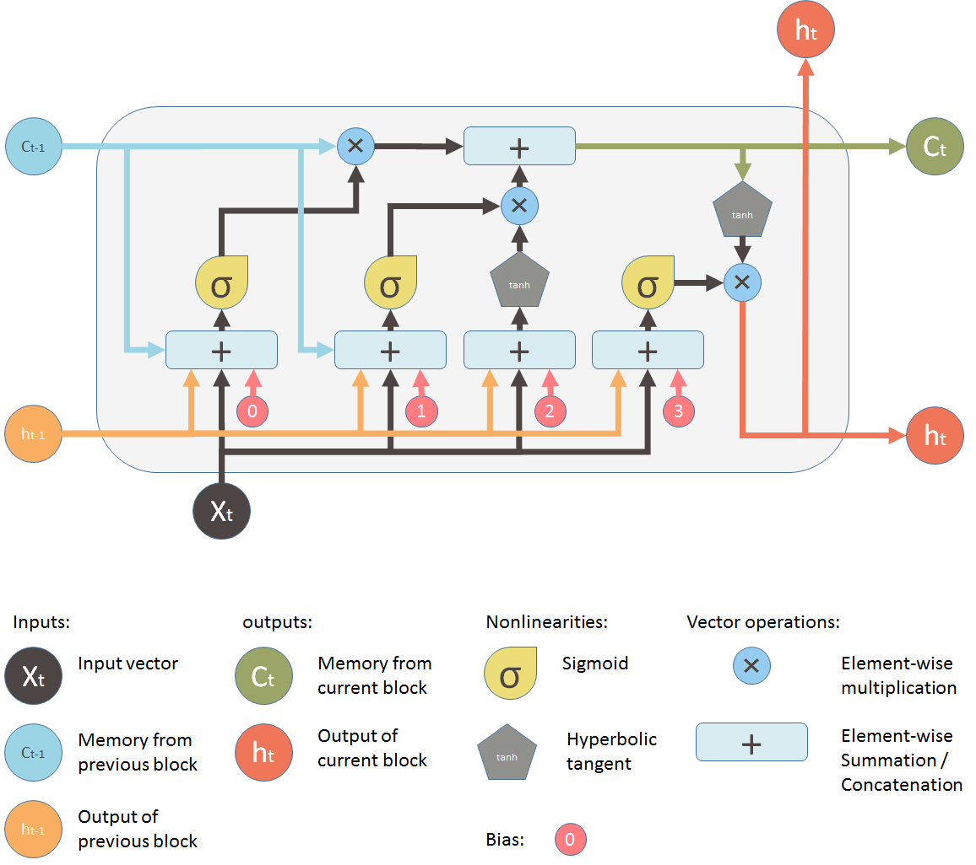
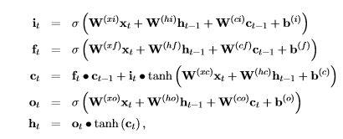
Review of model architecture
The input gate: The input gate adds information to the cell state
The forget gate: The forget gate removes the information that is no longer required by the model
The output gate: The output gate selects the information to be shown as output to the next step in the sequence
https://medium.com/mlreview/understanding-lstm-and-its-diagrams-37e2f46f1714

Slide 8
Data generation
Implemented a data generator function that split the data into N/b input batches obtained sequentially
Each batch in the batch set had a set batch size (b)
Each batch of input data had a corresponding output batch of data of the same size
The corresponding output batch to each input batch was generated by randomly selecting one value from the original data set that was between x+b and x+b+5 values ahead
Input Data:
[x0,x10,x20,x30],[x1,x11,x21,x31],[x2,x12,x22,x32]
Corresponding Output Data:
[x1,x11,x21,x31],[x2,x12,x22,x32],[x3,x13,x23,x33]

Slide 9
LSTM Setup
Hyperparameters:
The dimensionality of the data: 1
The number of continuous time steps considered for each optimization step: 50
The number of data points in each batch (or time step): 500
The number of LSTM layers: 3
The number of nodes in each of the three layers of the LSTM cell: [200, 200, 150]
The dropout percent: 20%
Loss and Optimization:
Loss Metric: Mean Squared Error
Optimization: Adam

Slide 10
LSTM Training and Validation
30 Epochs Using the Following Procedure for each Epoch
For full sequence length of training data
  Unroll a set of batches
  Train the neural network with the unrolled batches
Calculate the average training loss
For each starting point in the test set
  Update the LSTM state by iterating through the previous data points found before the test point
  Make predictions for 50 steps continuously, using the previous prediction as the current input
  Calculate the MSE loss between the 50 points predicted and the true stock prices at those time stamps

Slide 11
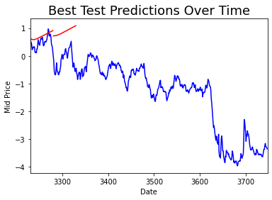
Initial results
Best Epoch = 30
Loss = 0.084
Mean Squared Error = 58.598

Slide 12
Linear Regression

Slide 13
Basic regression model
The equation for linear regression can be written as:
Y = w0x0 + w1x1+w2x2+……..+wnxn+b
Where, x₁, x₂,….x_{n} represent the independent variables while the coefficients w₁, w₂, …. w_{n} represent the weights.

Slide 14
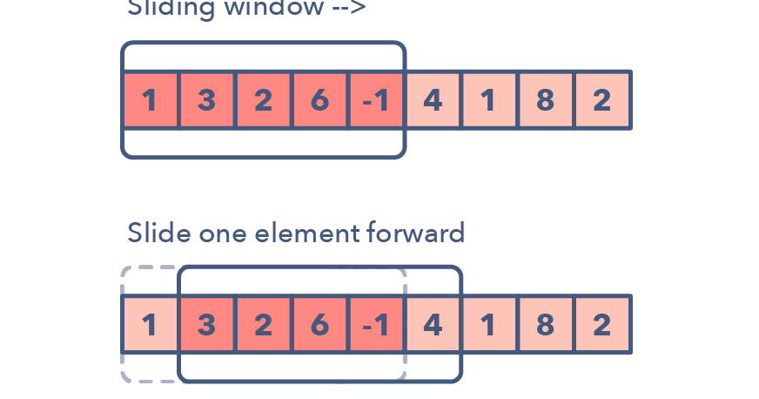
Data Preprocessing
In time series prediction, the time series are typically expanded into three or higher-dimensional space by restructuring the series into a data frame to look like a supervised learning problem. This can be done by using previous time steps as input variables and assigning future time step as the output variable.
** The data processing in this step was reproduced for the Linear Regression, Decision Tree Regression, and XGBoost Models
The Sliding Window Method

Slide 15
Regression model set up
Training Split: 80%
Validation Split: 20%
Loss Function: Mean Squared Error

Slide 16
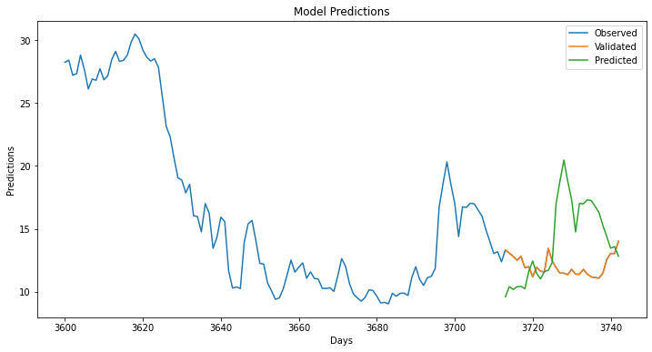
Linear regression Results
Validation Mean Squared Error: 19.114
Prediction Mean Squared Error: 0.190

Slide 17
Decision tree regression

Slide 18
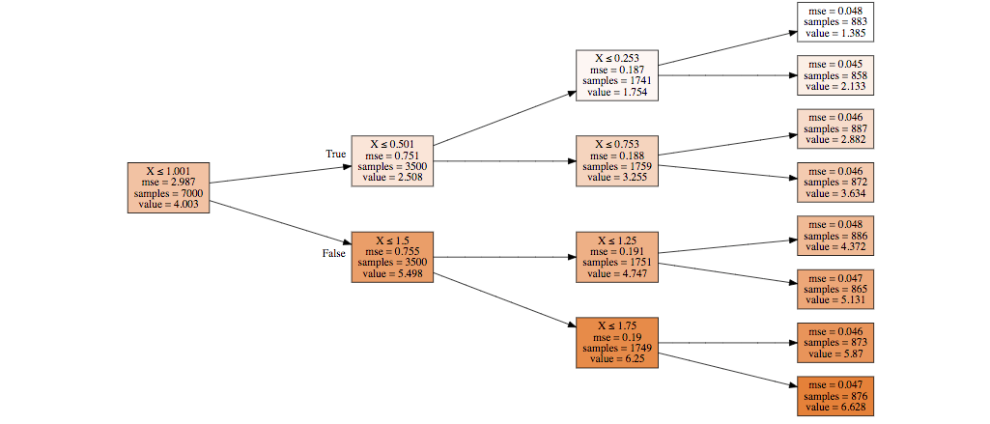
Basic Decision tree regression model
Initially, all values in the training set are grouped into one large node.
The algorithm selects data splits that minimize the sum of the squared deviations from the mean in the two separate partitions
The same splitting rule is applied to each of the new branching execution
This process continues until each node reaches a user-specified minimum node size and becomes a terminal node

Slide 19
Decision Tree model setup
Training Split: 80%
Validation Split: 20%
Loss Function: Mean Squared Error

Slide 20

Decision tree regression results
Validation Mean Squared Error: 35.598
Prediction Mean Squared Error: 3.755

Slide 21
XG boost regression

Slide 22
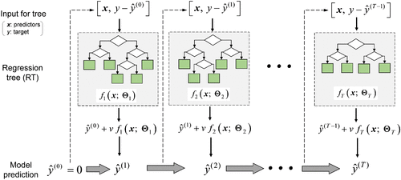
XG Boost Model Design Overview
The objective of the XGBoost model is given as:
Obj = L + Ω
Where,
L is the loss function which controls the predictive power
Ω is regularization component which controls generalizability and overfitting
Gradient boosting is an approach where new models are created that predict the residuals or errors of prior models and then added together to make the final prediction

Slide 23
3 Xg boost models created
Basic model with default hyperparameters
4 Fold Cross Validated
5 Fold Cross Validated with Randomized Hyperparameter Search

Slide 24
Basic XG boost model
Default Hyperparameters
5 Boosting Rounds
Results:
Mean Squared Error: 29.536

Slide 25
Xg boost with 4 fold cross validation
Max tree depth: 4
Number of validation folds: 4
Number of boosting rounds: 5
Results:
train-rmse-mean train-rmse-std test-rmse-mean test-rmse-std
0 21.986686 0.136333 21.987640 0.446506
1 15.719848 0.093633 15.735410 0.340168
2 11.434488 0.061982 11.470236 0.257726
3 8.569930 0.040131 8.630230 0.185066
4 6.721699 0.025848 6.809362 0.138029

Slide 26
Xg boost model with 4 fold cross validation and randomized hyperparameter search
Searched HyperParameter Space
Samples per tree: [0.2, 0.3, 0.4, 0.5, 0.6, 0.7]
Learning Rate: [0.04, 0.06, 0.08, 0.1, …, 0.98, 1.0]
Maximum Tree Depth: [3,4,5,6,7,8,9,10]
Number of Estimators: [50, 100, 150, 200]
Best Model Found
Samples per tree: 0.2
Learning Rate: 0.32
Maximum Tree Depth: 3
Number of Estimators: 100

Slide 27
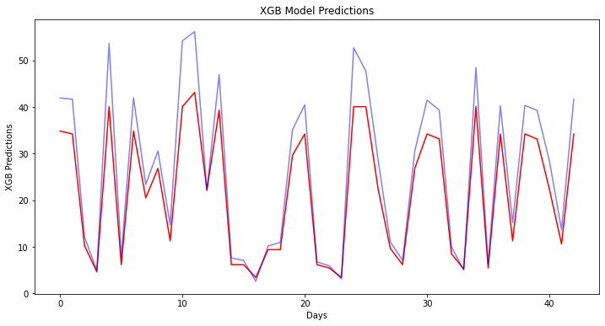
Results with best hyperparameter combination
MSE: 29.470

Slide 28
One day ahead prediction modeling

Slide 29
Short term vs long term prediction
Despite the challenges of predicting stock market price movement for time periods far into the future, predicting day to day stock market movement (one step ahead), has been much more successful. Out of curious comparison, I created 2 models to predict single day market movements and compared the performance to the future prediction models

Slide 30
2 Moving average models
Simple Moving Average
Exponential Moving Average
The major difference between the exponential moving average (EMA) and the simple moving average is how the data values are weighted. The EMA assigns larger weights to recent prices, while the SMA assigns equal weights to all values. Since the EMA places a higher weighting on recent data than on older data, it is more reactive to the latest price changes than SMAs.

Slide 31
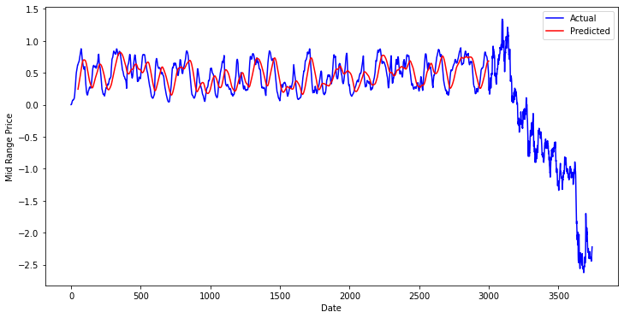
Simple moving average
The simple moving average was calculated with a window size of 50 days and resulted in an MSE error of 0.410
The simple moving average (SMA) is calculated by adding recent prices and then dividing by the number of time periods in the calculation average.
SMA = (A_1 + A_2 + ... + A_n)/n
where:
A_n = the price of an asset at period n
N = the total number of periods​

Slide 32
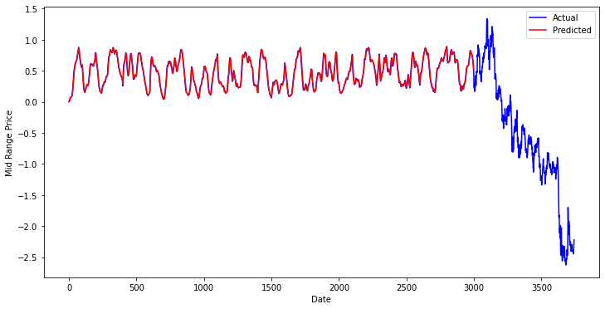
Exponential moving average
The exponential moving average was also calculated with a window size of 50 days and a decay rate of 0.5. The resulting MSE error was 0.007
The exponential moving average (EMA) is a moving average that places a greater weight on the most recent data points. An exponentially weighted moving average reacts more significantly to recent price changes than a simple moving average
EMAToday​ = ​(ValueToday​∗(Smoothing/1+Days)) + EMAYesterday​∗(1−(Smoothing/1+Days​))​

Slide 33
Initial conclusions and next steps
The progress so far demonstrates the models with the best predictive power to be the Linear Regression model and the LSTM model. The success of tree-based models has been poor, however this may be a matter of more thoughtful hyperparameter tuning. The next steps in this project will be improvement of each model’s accuracy through hyperparameter tuning. I will also test the generalizability of all models by testing them on multiple tickers to expose them to new data.

Slide 34
Simple model improvement through hyperparameter Tuning

Slide 35

Ridge regression Model
By adding a bias term to the regression coefficient estimates, ridge regression reduces the standard errors. The ridge regression algorithm works by imposing a penalty on the size of the coefficients according to the following equation:
$$\min_{w}||Xw−y||_{2}^{2}+α||w||_{2}^{2}$$
α ≥ 0 controls the amount of coefficient shrinkage. The larger the value of α, the greater the amount of shrinkage

Slide 36
Ridge regression model set up
Training Split: 80%
Validation Split: 20%
Loss Function: Mean Squared Error
Alpha: 0.5

Slide 37
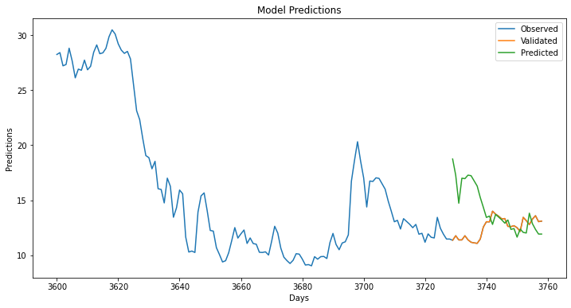
Ridge regression results
Validation Mean Squared Error: 19.114
Prediction Mean Squared Error: 0.190

Slide 38

Lasso regression model
Like ridge regression, the lasso regression algorithm adds a penalty term to the loss function. Unlike ridge regression, the penalty term for lasso regression is the absolute sum of the coefficients multiplied by alpha. The objective function to minimize is:
$$\min_{w}\frac{1}{2n_{samples}}||Xw−y||_{2}^{2}+α||w||_{1}$$
where α is a constant and ||w||₁ is the ℓ1-norm of the coefficient vector.

Slide 39
Lasso regression model set up
Training Split: 80%
Validation Split: 20%
Loss Function: Mean Squared Error
Alpha: 0.1

Slide 40

Lasso regression results
Validation Mean Squared Error: 19.114
Prediction Mean Squared Error: 0.195

Slide 41
Decision tree regression with randomized hyperparameter search - Logic
Reduce Overfitting
Efficiently Attempt Several Hyperparameter Combinations Over a Large Hyperparameter Space
Use Optimized Hyperparameter Combination to Learn More About the Data

Slide 42
Decision tree regression with randomized hyperparameter search – Model set up
Training Split: 80%
Validation Split: 20%
Loss Function: Mean Squared Error
10 Hyperparameter Combinations
5 Fold Cross Validation Each Hyperparameter Combination

Slide 43
Decision tree regression with randomized hyperparameter search
Searched HyperParameter Space
Maximum Tree Depth: [2,3,4,5,6,7,8,9,10]
Maximum Features for Best Split: [auto , sqrt]
Quality of Split Criterion : [mse, mae]
Node Split Strategy: [best, random]
Min Samples per Leaf: [5,6,7,…..,19,20]
Best Model Found
Maximum Tree Depth: 6
Maximum Features for Best Split: sqrt
Quality of Split Criterion : mean squared error
Node Split Strategy: best
Min Samples per Leaf: 5

Slide 44
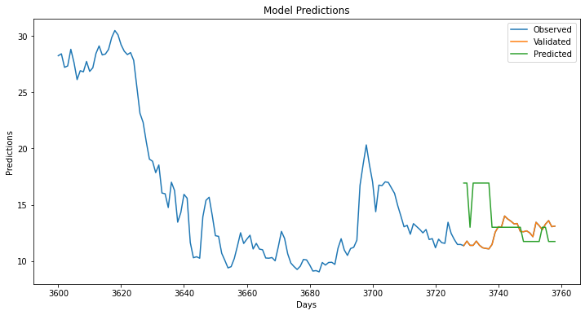
Results with best model
Validation Mean Squared Error: 2.250
Prediction Mean Squared Error: 0.368

Slide 45
Compiled results
Model | Mean Squared Error
One Day Ahead, Exponential Moving Average | 0.007
Ordinary Least Squares Linear Regression | 0.190
Ridge Regression | 0.190
Lasso Regression | 0.195
Decision Tree with Hyperparameter Search | 0.368
One Day Ahead, Simple Moving Average | 0.410
Decision Tree | 3.755
XGBoost with Hyperparameter Search | 29.470
XGBoost, default | 29.536
XGBoost with Cross Validation | 46.362
LSTM Neural Network | 58.598

Slide 46
Initial conclusion
Ordinary Least Squares Regression provided the best results for future predictions on this particular dataset
One day ahead predictions were the most accurate, but were limited in use for some purposes that require insights farther into the future
Models with a tendency towards overfitting were less effective for predicting AAL stock market movement, even after robust hyperparameter tuning

Slide 47
final steps
Next I will look at how the entire series of models performs on alternate tickers to check model performance on entirely different stock market trends

Slide 48
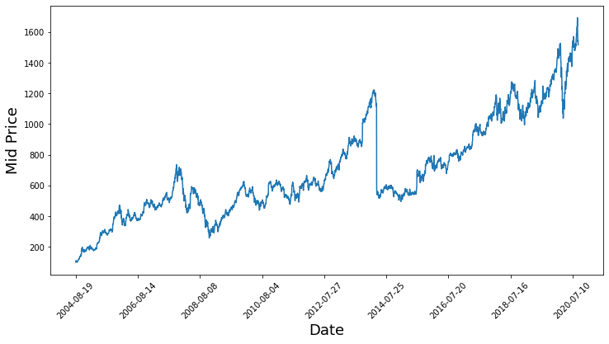
GOOGL
Model | Mean Squared Error
One Day Ahead, Exponential Moving Average | 5.000
Ordinary Least Squares Linear Regression | 10.697
Ridge Regression | 10.697
Lasso Regression | 10.702
One Day Ahead, Simple Moving Average | 40.000
Decision Tree with Hyperparameter Search | 1021.567
Decision Tree | 6990.854
XGBoost, default | 14913.590
XGBoost with Hyperparameter Search | 14970.071
XGBoost with Cross Validation | 23545.061
LSTM Neural Network | 38460.100

Slide 49
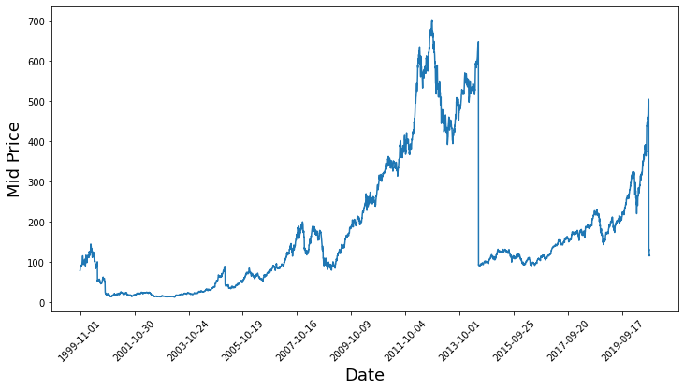
AAPL
Model | Mean Squared Error
One Day Ahead, Exponential Moving Average | 0.100
One Day Ahead, Simple Moving Average | 6.000
Ordinary Least Squares Linear Regression | 39.460
Ridge Regression | 39.460
Lasso Regression | 39.470
Decision Tree with Hyperparameter Search | 570.927
LSTM Neural Network | 1902.000
XGBoost, default | 2075.320
XGBoost with Hyperparameter Search | 2143.251
XGBoost with Cross Validation | 3469.328
Decision Tree | 17819.173

Slide 50
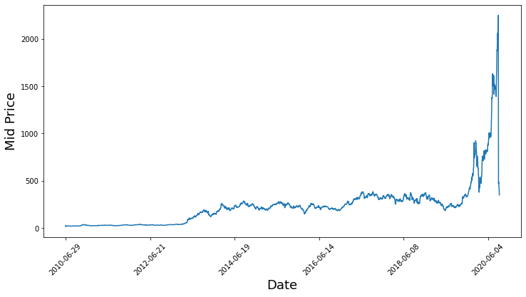
TSLA
Model | Mean Squared Error
One Day Ahead, Exponential Moving Average | 1.000
One Day Ahead, Simple Moving Average | 80.000
LSTM Neural Network | 1592.000
XGBoost with Hyperparameter Search | 2316.076
XGBoost, default | 2853.577
XGBoost with Cross Validation | 11024.58
Lasso Regression | 17793.782
Ridge Regression | 17794.482
Ordinary Least Squares Linear Regression | 17794.484
Decision Tree with Hyperparameter Search | 209766.112
Decision Tree | 467594.970

Slide 51
AAL
Model | Mean Squared Error
One Day Ahead, Exponential Moving Average | 0.007
Ordinary Least Squares Linear Regression | 0.190
Ridge Regression | 0.190
Lasso Regression | 0.195
Decision Tree with Hyperparameter Search | 0.368
One Day Ahead, Simple Moving Average | 0.400
Decision Tree | 3.755
XGBoost with Hyperparameter Search | 29.470
XGBoost, default | 29.536
XGBoost with Cross Validation | 46.362
LSTM Neural Network | 58.598

